Slide 1
INTEGRATING ARTIFICIAL INTELLIGENCE INTO CONSTRUCTION: CHALLENGES, BENEFITS, AND STRATEGIES
Week 12 Ed Elowson

Slide 2
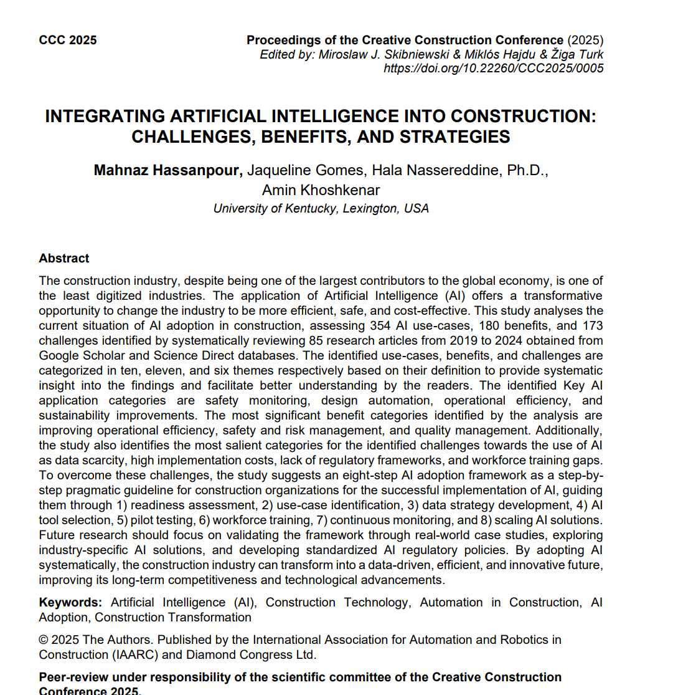
Screenshot

Slide 3

Link to the source
https://www.iaarc.org/publications/fulltext/04_6_CCC2025_Paper.pdf

Slide 4
Main Findings
The article concludes that AI has major transformative potential in construction but faces equally significant barriers. After reviewing 85 peer‑reviewed studies, the authors identify 354 AI use cases, 180 benefits, and 173 challenges. The most impactful applications include safety monitoring, design automation, operational efficiency, and sustainability improvements. The most frequently cited benefits are operational efficiency, safety and risk management, and quality improvement. However, adoption is slowed by challenges such as data scarcity, high implementation costs, technical limitations, and—critically—“lack of regulatory frameworks” (quoted from the article). To address these issues, the authors propose an eight‑step AI adoption framework that guides organizations from readiness assessment to scaling solutions.

Slide 5
Broader Implications
The findings suggest that AI’s integration into construction has implications far beyond the industry itself. Because construction represents 13% of global GDP, improvements in efficiency, safety, and sustainability can have large-scale economic and social benefits. AI-driven safety systems can reduce workplace injuries, while automation and predictive analytics can lower costs and minimize waste—supporting broader societal goals such as environmental sustainability and safer working conditions. At the same time, the article highlights societal challenges, including ethical concerns, data privacy, and the need for workforce reskilling, noting that “ethical issues such as data privacy, job loss, and transparency” contribute to resistance. This underscores the need for public policy, education systems, and industry standards to evolve alongside AI.

Slide 6
Relevance and Potential Influence in the Construction Industry
For the construction sector, the article’s insights are highly actionable. AI can directly address chronic industry problems—delays, cost overruns, safety incidents, and productivity gaps—by enabling predictive analytics, automation, and real‑time monitoring. The study emphasizes that AI can “transform the industry to be more efficient, safe, and cost‑effective,” but only if organizations adopt structured strategies and governments develop standardized AI regulatory policies. The proposed eight‑step framework provides a roadmap for firms to adopt AI responsibly, while the identification of challenges (especially data and regulatory gaps) highlights where industry leaders and policymakers must focus. If implemented effectively, AI could shift construction toward a data‑driven, automated, and more competitive future.

Slide 7
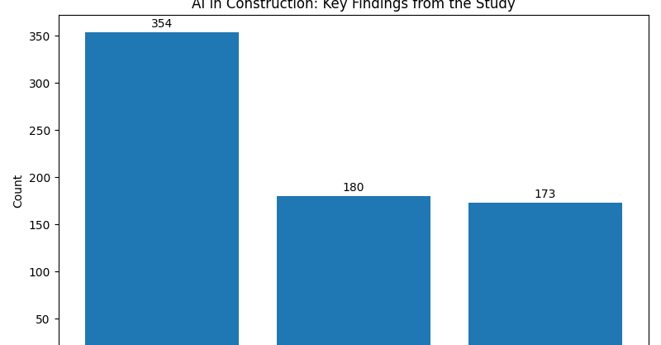

Slide 8
